Slide 1

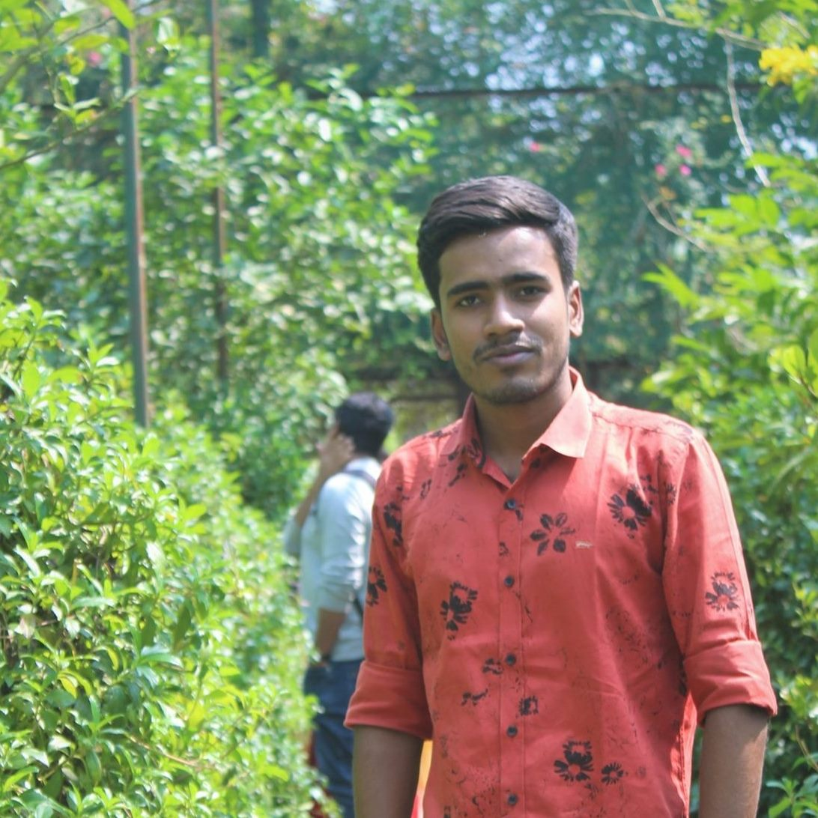


GEN203
Group 03
Presented by
MD. Nezarul Islam
2018-1-60-235
Jannatul Haq Nayeem
2018-1-60-224
MD. Rayhun Khan
2018-1-60-225

Slide 2
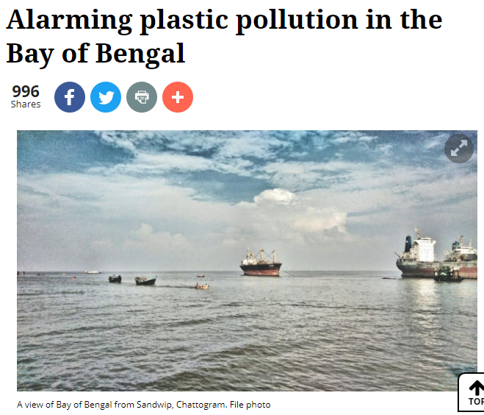
How economic growth is failing to ensure environmental sustainability for people in Bangladesh
Every year about 2 lakh tons of plastic enter the Bay of Bengal from Bangladesh.
Bangladesh is the 10th most polluting countries in the world.
The corals of St. Martin Island are almost dead.
Article link
https://www.thedailystar.net/opinion/environment/news/alarming-plastic-pollution-the-bay-bengal-1784278

Slide 3




,
Sources of the Problem
Mass tourist pressure
Poor waste management system
Shipbreaking
Use of less durable plastic

Slide 4

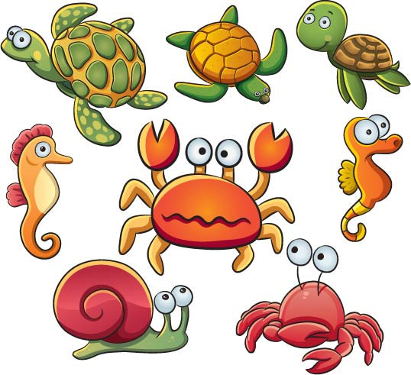

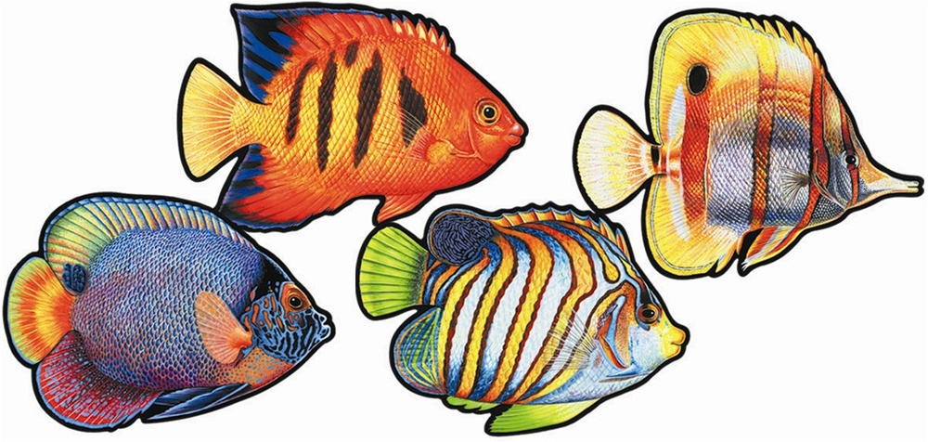

Human health
Marine animals
Effects and losses
Blue economy
Ground water

Slide 5
How economical growth is connected with plastic pollution problem?
If manufacturers stop using Plastic then they will have to spend more money for packaging and storage
Plastic is long lasting material, so if they use anything instead of plastic they have to be concern about the expired date of those material
In our country, if people and companies stop using plastic then it will increase the demand of jute bags and paper bags

Slide 6

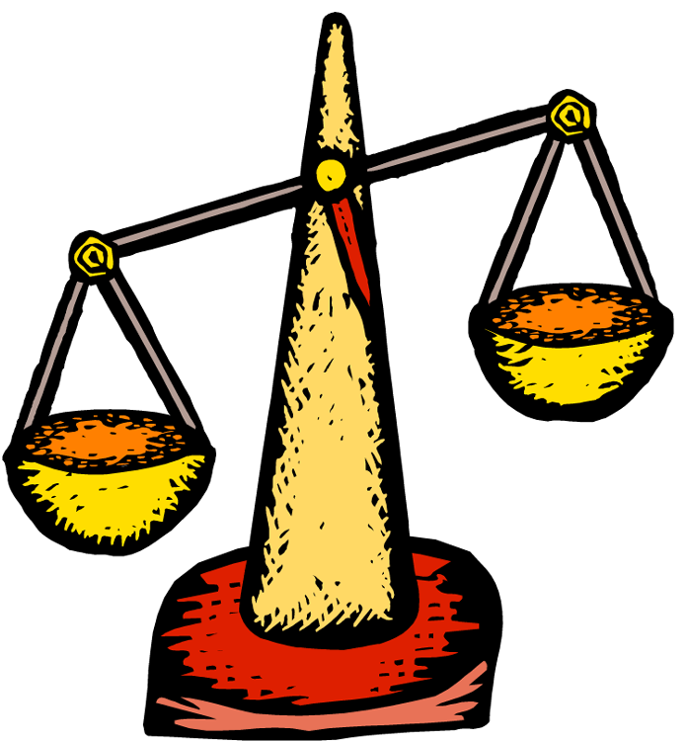
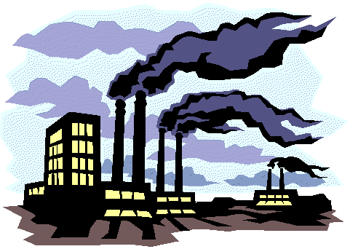
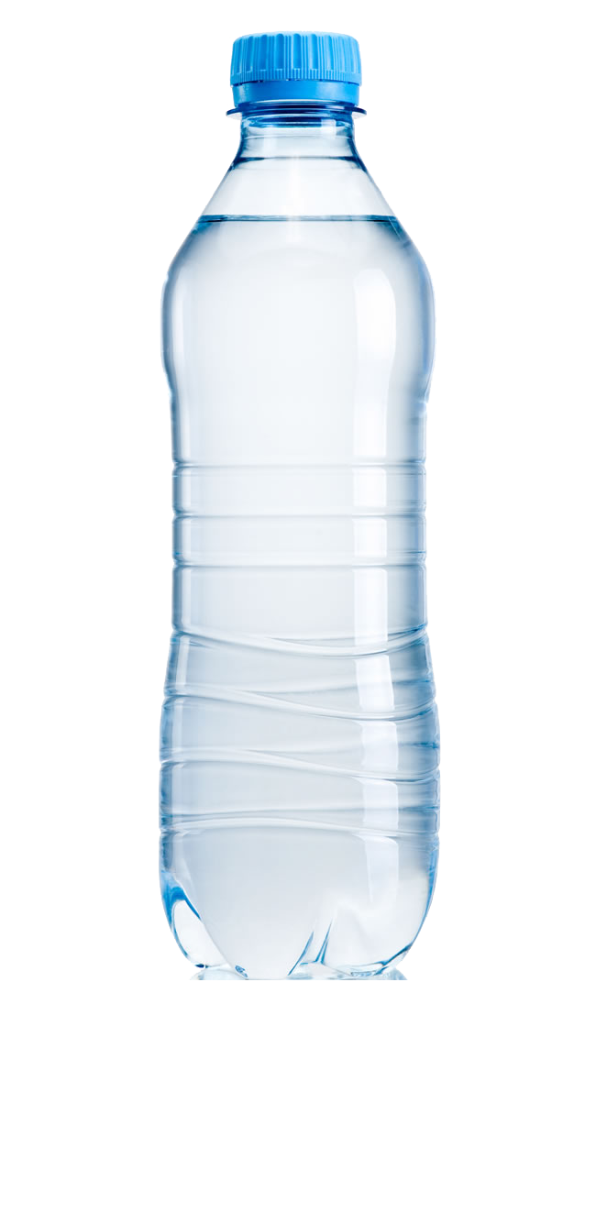
Economical Growth
Urban area consumption
Ecological balance
Industrialization
Single use plastic

Slide 7
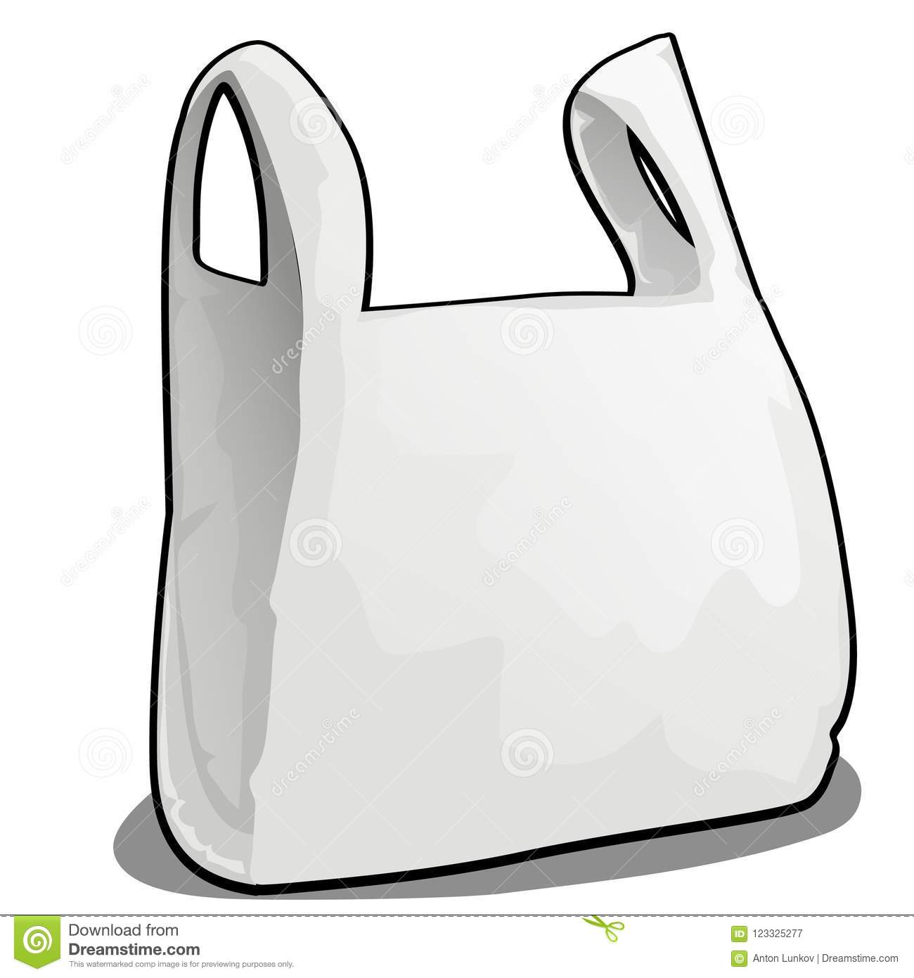



Whom to blame?
20 years
Lack of coordination in
Ministries
500 years
Division
NGO
Private sectors
450 years
50 years

Slide 8
Can we solve this plastic pollution problem?
Using alternative of plastic (Jute bags, paper packaging)
Inventing disposable plastic.
Enforcement of law, for example ban on plastic
Increasing tax on plastic manufacturers to discourage people producing plastic.
Rising awareness through social media or advertisement.
Promote recycling and biodegradable plastic.

Slide 9
How others country is dealing with this problem?
Korea removed 66000 tones marine waste
China, Kenya and Morocco have implemented a ban on thin plastic bags.
Canada implemented a ban on plastic bags with thickness less than 50 microns.
Ireland was the first country to place a significant tax on plastic bags.

Slide 10
Thank You

